Slide 1
DHS Zoom Brief
17 August 2023
Ms. Katherine Escobar (NIEMOpen Project Governing Board Chair)
Kamran Atri (NBAC TSC Co-Chair)
Thomas Krul (NBAC TSC Co-Chair)

Slide 2
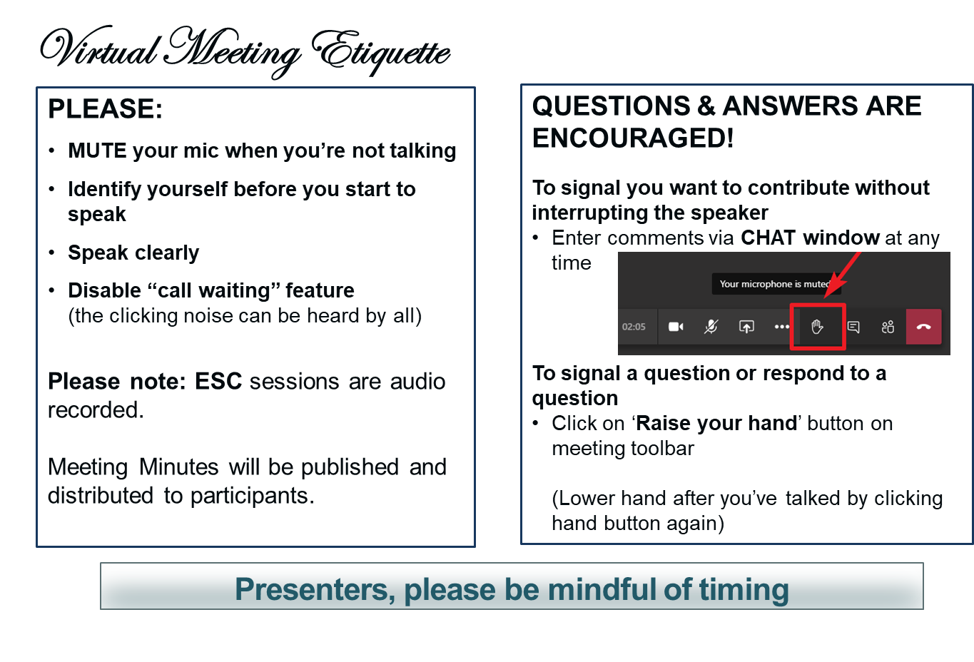
Making the most of our session
Notes:
VOTING: The usual method of voting is viva voce (by voice). To accommodate the virtual setting the chair may ask members to “Raise your hand” to signal aye or no.

Slide 3
Agenda
OASIS Contributor License Agreements (CLA) (DHS S&T premier sponsor with signed OASIS Entity CLA)
Individual-CLAs required
Need GitHub Account to register I-CLA
Fill out I-CLAs)
Domain Space Sub-Committees Governance (formerly Domain Stewardship Agreements)
Conservatorship
NIEM Model Version 6.0 OASIS Open Project
“Standards” process (Project Specification Draft, Project Specification, OASIS Standard)
NIEMOpen resources (Git Repos, mailing lists, calendars, IEPD/MEP repos, social media,…)
Q&A
Introduction (Kamran Atri, Thomas Krul, Katherine Escobar)
NIEMOpen Project Organization
OASIS Staff Org Chart
Project Governing Board (PGB) (Executive Leadership)
PGB Expert Voting Members (TSC Representatives)
PGB Non-Voting Members
Technical Steering Committees (TSC)
Maintainers (GitHub Configuration Control)
Project Sponsors
OASIS Lightweight Rules
Transition
NBAC TSC Governance Policy and Procedures
5 min BREAK

Slide 4

NIEM open project governance
Sponsor Appointed Voting Members (8)
Expert Voting Members (3)
Expert Non-Voting Members (2)
NIEM OPEN
Project Governing Board
Executive Liaison Group
Technical Steering Committee
(NIEM NMO)
Technical Steering Committee
(NIEM NBAC)
Technical Steering Committee
(NIEM NTAC)
Communications & Outreach
Subcommittee
(ex. E-Management) Subcommittee)
(ex. MilOps Subcommittee)
LEGEND
PGB
TSC
SUBCOMMITTEE
TIGER TEAM
ADVISORY GROUP
CORE
(Harmonization Subcommittee)
Domain Management & Standing Rules Tiger Team
Notes:
Slide updated 12/29/22
On 20 October 22 OASIS stood up NIEM Open Project. This Organization Structure was proposed and approved by the PGB on 20 October with exception of the two tiger teams shown which are currently being considered by the NBAC and NMO TSCs. The Project Governing Board (PGB) was established with membership from six Founding Sponsors (Joint Staff J6, Department of Homeland Security Science & Technology (DHS S&T), Georgia Tech Research Institute (GTRI), Equivant, sFractal, and the National Association of Justice Information Systems (NAJIS).
5.1 Overall guidance for the Project is provided by its Project Governing Board (or PGB). The PGB is composed of one voting member from each Project Sponsor who elects to appoint a PGB member, and (a) if the PGB has one or more Technical Steering Committees, one voting expert representative from each TSC, elected or appointed by that TSC,… The PGB may create additional non-voting PGB member seats for expert representatives to be elected by the TSC or appointed by the PGB (Open Project Rules - OASIS Open (oasis-open.org)
The PGB approved 3 Technical Steering Committees (TSCs) by resolution and their respective governance documents (NIEM Management Office TSC, NIEM Business Architecture Committee TSC, and NIEN Technical Steering Committee TSC) and appointed their respective Co-Chairs.
6. Technical Steering Committees - The PGB shall form a Technical Steering Committee (or TSC) by a resolution of the PGB. A Project’s TSC members shall be composed of the persons, selected in the manner, and chaired by such person as is provided by that resolution. The PGB must create and publish process documentation for each TSC, outlining the requirements for joining and voting in that TSC, consistent with these Rules (including Section 10), and shall specify whether the Chair(s) of the TSC are selected by the PGB, or by that TSC’s members. The TSC shall have the duties to advise the PGB and such others as are specified by the PGB, so long as consistent with these Rules and OASIS policies (Open Project Rules - OASIS Open (oasis-open.org).
The TSCs may establish Subcommittees and Tiger Teams. There were 17 former NIEM Domains (Communities of Interest (COIs)) at the standup of NIEM OPEN under the auspices of OASIS. The NBAC TSC is recommending these Domains transition as NBAC subcommittees as outlined in the NBAC TSC approved Governance Document. Each Domain will elect a Steward and/or Chairs and establish Standard Operating Procedures IAW OASIS rules.
In addition to Domains, the Harmonization Subcommittee is constituted under the NBAC TSC. This subcommittee is responsible for oversight of NIEM CORE (The NIEM core consists of data elements that are commonly understood and defined across domains, such as person, activity, document, location, and item. It’s governed jointly by all NIEM domains and the NIEM Harmonization Process.). https://www.niem.gov/about-niem/niem-model
Updating the NIEM core
If a data requirement isn't already found in the overall NIEM model and is applicable to many domains, it can be submitted through the NBAC for consideration for NIEM core. A primary function of the NBAC is to coordinate the ongoing harmonization process between NIEM core and domains.
Model harmonization
Harmonization is an ongoing process to ensure no duplication in the model as updates are made and it evolves to accommodate new community business requirements. The harmonization process integrates these new requirements while still ensuring data elements exist only once in the model. There are two types of harmonization, between domains and between NIEM core and domains.
Harmonization review process
Each domain has its own process for updating its data model, depending on the domain’s business needs and resources available.
For harmonization between NIEM core and domains, every new business requirement that's identified follows a review process, as follows:
Issue is identified and an initial assessment is conducted by the NIEM … developers or self-identified by the domain(s).
Issue is reviewed by the NBAC and is assigned to a team consisting of NBAC TSC members with knowledge, expertise, and/or vested interest in resolving the issue.
The NBAC team works to resolve the issue and provides a recommended solution.
The NBAC reviews the recommended solution and accepts, rejects, or defers it for more information, which the team then supports.
When the solution is accepted, NIEM lead developers will include it in the next release. https://www.niem.gov/about-niem/niem-model
The Executive Liaison Group is an informal advisory group composed of members of the former NIEM Executive Steering Committee and senior NIEM advocates. It serves in a consultive role to the PGB at the discretion of the PGB.
As of 12-27-2022, there are 1 NBAC TSC Tiger (Domain Management & Standing Rules) and 1 NMO TSC Standing Committee (Communications & Outreach) in the offing.

Slide 5
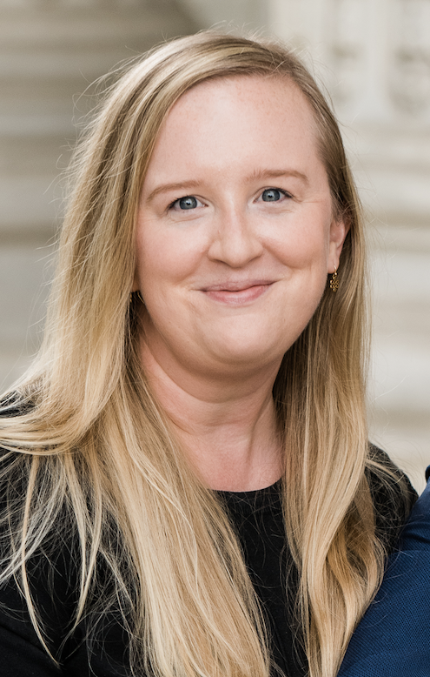

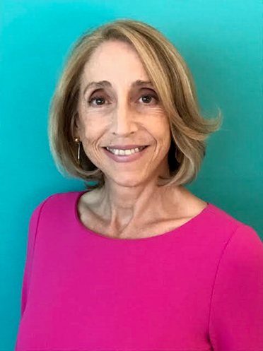
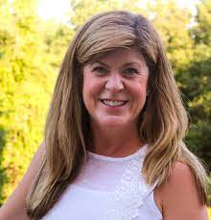
OASIS STAFF/ OP ADMINISTRATORS
Mr. Chet Ensign – Chief Technical Community Steward at OASIS/ OP Administrator
Ms. Carol Geyer – OASIS Open Chief Development Officer
Ms. Kelly Cullinane – OP Administrator
Ms. Cathie Mayo – OASIS Controller
Notes:
Introduce OASIS Staff to new PGB Members
All 4 will have speaking roles during the remainder of the meeting.

Slide 6





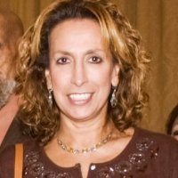










Project Governing Board
Sponsor Appointed Voting Members
Ms. Katherine Escobar
PGB Chair
Deputy Division Chief, Data and Standards Division at Joint Staff J6 and NIEM Managing Director
Ms. Christina Bapst-Stump
Science and Technology Directorate, US Department of Homeland Security
Mr. Gary Egner
Director Business Development, Equivant
Mr. John Wandelt
Principal Research Scientist, Georgia Tech Research Institute
Mr. Duncan Sparrell
CSO sFractal Consulting
Ms. Maria Cardiellos
Executive Director
Integrated Justice Information Systems Institute
Mr. Payton Lamb
Data Engineer
Commonwealth of Virginia
Office of the secretary of Administration
Office of Data Governance and Analytics
Ms. April Mitchell (Acting)
IT Specialist, CJIS/ITMS/ETSU
Notes:
NO Member Updates from 11 April PGB
Open Project Rules - OASIS Open (oasis-open.org)
5.1 Overall guidance for the Project is provided by its Project Governing Board (or PGB). The PGB is composed of one voting member from each Project Sponsor who elects to appoint a PGB member, and (a) if the PGB has one or more Technical Steering Committees, one voting expert representative from each TSC, elected or appointed by that TSC, or (b) otherwise, the PGB may appoint at least one and no more than two voting expert representatives from its community of contributors. The PGB may create additional non-voting PGB member seats for expert representatives to be elected by the TSC or appointed by the PGB. The PGB membership of all such members of any type is conditioned on satisfaction of the CLA requirement of Section 5.2. Voting status on the PGB may be affected by the provisions of Section 5.7.

Slide 7

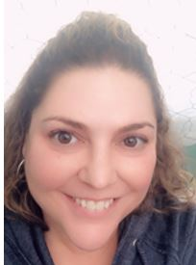

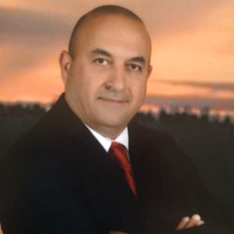

PGB EXPERT VOTING MEMBERS
Technical Steering Committees
Thomas Krul
Co-Chair
NIEM Business Architecture Committee (NBAC) Technical Steering Committee (TSC)
Jim Cabral
Vice President, Court Relations, InfoTrack
Beth Smalley
Co-Chair
NIEM Management Office (NMO) Technical Steering Committee (TSC)
PGB NON-VOTING MEMBERS
Technical Steering Committees
Dr. Scott Renner
Co-Chair
NIEM Technical Architecture Committee (NTAC) Technical Steering Committee (TSC)
Kamran Atri
Co-Chair
NIEM Business Architecture Committee (NBAC) Technical Steering Committee (TSC)
Notes:
We currently have 10 Sponsors and 3 TSCs. Currently 11 PGB voting members, 2 Non-Voting Members.
Thomas Krul will represent the NBAC TSC as voting member for the next 6 months.

Slide 8
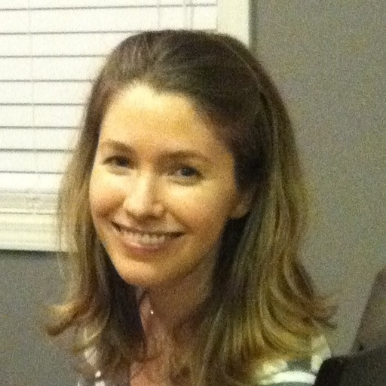


NIEM Open maintainers As of July 2023
GitHub Repos | Primary | Alternates
NIEM Open | Ms. Christina Medlin & Mr. Aubrey Beach | Mr. Tom Carlson, Ms. Shunda Louis
NBAC TSC | Ms. Christina Medlin & Mr. Aubrey Beach | Mr. Tom Carlson, Ms. Shunda Louis, Mr. Steve Sullivan
NTAC TSC | Mr. Tom Carlson & Christina Medlin | Mr. Aubrey Beach, Ms. Shunda Louis, Dr. Scott Renner
NMO TSC | Mr. Aubrey Beach | Ms. Shunda Louis, Mr. Steve Sullivan, Mr. Tom Carlson (Training)
Ms. Christina Medlin
Mr. Aubrey Beach
Mr. Tom Carlson
Notes:
Tom Carlson added to assist with transition of Training Repo to NIEMOpen.

Slide 9

NMO, NBAC, & NTAC TSC Co-Chairs
TSC | Approved (TSC CHAIRS)
NMO TSC | Ms. Katherine Escobar & Ms. Beth Smalley
NBAC TSC | Mr. Kamran Atri & Mr. Thomas Krul
NTAC TSC | Dr. Scott Renner & Mr. Jim Cabral
NTAC TSC
Mailing Lists
NIEMOpen: https://lists.oasis-open-projects.org/g/niemopen
PGB: https://lists.oasis-open-projects.org/g/niemopen-pgb
NTAC TSC: https://lists.oasis-open-projects.org/g/niemopen-ntactsc
NBAC TSC: https://lists.oasis-open-projects.org/g/niemopen-nbactsc
NMO TSC: https://lists.oasis-open-projects.org/g/niemopen-nmotsc
NBAC TSC
NMO
TSC

Slide 10











NIEMOpen Sponsorship
Current Sponsors (CY 2023 Rates)
Potential Sponsors
Premier
$65K
$1.2K
S&T
S&T
Premier
$65K
$1.2K
Premier
$65K
Premier
$65K
Premier
$65K
$25K
+
DHS OBIM
$5.8K
$2.4K
$1.2K
$2.5K
$5.8K
=
Revenue | Dues | CY 2023 Net
$252.3K | $125K | $127.3K
Projected CY 2023 Net
$263.1K
Notes:
OBIM sponsor paperwork in progress
Microsoft still on target as sponsor Jul – Sep 2023
DISA new potential sponsors

Slide 11
OASIS Lightweight Rules
Table of Contents w/Links
1. Purpose of Open Projects
2. Project Formation
3. Roles of Parties in the Project
4. Contributors
5. Project Governing Board and Project Sponsors
6. Technical Steering Committees
7. Project Chairs, Maintainers, and Technical Steering Committees
8. Repositories and Project Tools
9. Visibility and Archival Permanence
10. Project Governance: Decisions and Meetings
11. Progression of Project Work
12. Releases and Group Releases
13. Project Specifications
14. OASIS Standard Approval and External Submissions
15. Repository and Specification Licenses
16. Trademarks
17. CLAs and License Notices
18. Appeals and Application of Rules
Appendix A-1: Individual CLA
Appendix A-2: Entity CLA
Notes:
Chair introduces Cathie Mayo

Slide 12

Questions
Do any of the members have any questions?

Slide 13

BREAK

Slide 14
NBAC TSC Governance
NBAC TSC Admin Repo: https://github.com/niemopen/nbac-admin
NBAC TSC Governance Doc: https://github.com/niemopen/nbac-admin/blob/main/documents/(APPROVED)%20%20NIEMOpen%20NBAC%20TSC%20Governance%20Doc%20(Rev%202)%20%20v7%20%207-27-2023.pdf
NBAC TSC Scope
Composition
NBAC Chair/Co-Chair
NIEMOpen Domain Space Sub-Committees
Harmonization Sub-Committee
Contributing to NIEMOpen
Voting & At Large TSC Members
PGB Voting & Non-Voting Members
NBAC TSC Maintainers
Responsibilities
NBAC TSC Meetings
Decisions
Appeals
Instantiating a Sub-Committee
Conservatorship
Sub-Committee Nomination_Onboarding Instantiation
https://github.com/niemopen/nbac-admin/blob/main/sub-committee-documents/(FINAL)%20Sub-Committee%20Nomination_Onboarding_Instantiation%20v4%206-5-2023.pdf

Slide 15

NIEM Open Transition Progress
Complete
Draft POA&M
Draft and publish NIEM Open Charter
J6 Sponsorship
Transfer NIEM community Rosters/email distros
Conduct First Sponsor Kickoff Mtg
OASIS Admin Privileges
Web Presence (NIEMOpen.org)
Jira/Confluence
Revising NBAC & NTAC Governance Docs Agreements
TRANSITION ESC TO PGB ADVISORY BODY 20 OCT 22
KICKOFF PGB 20 OCT 22
Build Out NIEMOpen.org
Update NIEM Branding
Establish OASIS Jira & Confluence Site
Prepare the NIEM Conformance Targets Attribute Specification (CTAS) 3.0 for approval as a Project Specification (PS) (approved PS 2/23/23)
Planned/ In Progress
Weekly Synch w/ OASIS Staff
Assessing NIEM Model & NIEM GTRI GitHub Capital/Equities & Planning Transfer to OASIS
Researching OASIS Release Process and Planning 1st Release Under OASIS
Transition Domains as Subcommittees under NBAC TSC
Plan / Develop 6.0 Release under OASIS Rules
Submit NIEM 5.2 Model as an OASIS Open Project Release
Transfer Training Equities to NMO TSC Training Repo
Transfer legacy documents to NBAC Admin Repo historical-documents folder
To Be Accomplished
2023!
Physically Transfer NIEM Capital/Equities (Model, Specifications, Documentation) to OASIS
Implement “New” development and release processes (lead developer actions)
Submit NIEM Version 6.0 Project Specifications for Approval as OASIS Standard
Dec 2023 PS
Summer/Fall 2024 OS
Recurring/On-Going
Identify Potential Sponsors/Conduct Outreach
Populate OASIS Jira & Confluence Site
Conduct Bi-Weekly Synch w/ OASIS Staff
Obtain Contributor License Agreements

Slide 16
Contributor License Agreements

Slide 17
Domain-space sub-committees

Slide 18
Conservatorship
As Sub-Committees mature, some may reach stasis where there is no requirement to create new model content or exchanges. Additionally, there may be circumstances where a Sub-Committee is suspended, terminated, or otherwise becomes dormant. If a Sub-Committee is inactive, or without a Chair, or dormant for an extended period (6-12 months or as determined by the NBAC TSC), the NBAC TSC may retire the Sub-Committee and act as conservator for the Sub-Committee’s Domain Space model content.

Slide 19
Retiring a Domain Space Sub-Committee
Sub-Committee (SC) Chair informs NBAC TSC of Intent to retire Sub-Committee
Vacant Sub-Committee Chair
Sub-Committee assessed to be in-active
Document assessment results & inform PGB if inactive
Consult with PGB/
Sub-Committee
Retire Sub-Committee
Place model content in
conservatorship of NBAC TSC
Investigation & Assessment
Inactive
Document
Retire SC
Formulate Alternatives
Consult
Conservatorship
Start
Stop
NBAC TSC Chair/Co-Chairs investigates Sub-Committee and assesses status
Stop
Mentorship/remediation
Conservatorship
Provide Support
Provide mentorship/
remediation
Re-assess

Slide 20
Niem version 6.0 update
Content Changes
Core | Digital identity additions
International Human Services | New domain
Justice | National Crime Information Center (NCIC) code updates
MilOps | Minimum Essential Metadata updates
Surface Transportation | Model Minimum Uniform Crash Criteria (MMUCC) updates
General | NDR-related updates, including metadata, adapters, and roles Harmonization and issue resolution Code set updates OASIS namespace updates
Schedule
September | Project Specification Draft (PSD) 01
November | Submitted to PGB for approval as Project Specification (PS) 01
December | PGB vote for approval as Project Specification (PS) 01

Slide 21

Time Frame Version 6.0
The main driver of the timeline is how much time you want to spend working on the content. To drive to OS by end of year, you’d generally follow a schedule
Dec 2023
NIEM version 6.0 contributed to NIEMOpen Project and available to COI for download/use, and
Staged for submission as Open Project PS
Working Draft
Project Specification Draft
Project Specification
OASIS Standard
Spring to summer 2023
Summer 2023
Autumn/Winter (Dec) 2023
Summer/Fall 2024
Iterative work on contributions to prepare proposed PSD. Review and recommend WD to PGB for approval as PSD
PGB approval of PSD. Optionally, release of the PSD for broad public review. Iterations on PSD leading to recommendation to PGB to approve as PS
PGB approval of the PS. Collection of statements of use. PGB approval to submit for OS. Start 60-day public review.
End of 60-day review. Address any comments received. Hold Call for Consent. Issue press release and celebrate.
6.0 Project Specification (PS)
Model (includes schemas and documentation)
NDR
Code Lists Specification
Common Model Format Specification
Conformance Specification
Notes:
For 6.0, NTAC will be submitting the following for PS:
Model (includes the schemas and documentation)
NDR
Code Lists Specification
Common Model Format Specification
Conformance Specification
CTAS has already been approved as a PS. The old NIEM JSON specification is going to be refactored as a specialized representation of the NDR. The new Message Specification guidance document will be submitted as a formal project specification or as a project note.
The 6.0 Project Specification phase will run until the end of this year (CY2023). Candidates for OS are under discussion/consideration (model and the NDR ?) How quickly we'll be able to execute Oss is in planning. Spring might be a little soon. In addition to the 60-day public review and potential subsequent review cycles, we'll also need three statements of use from the community.

Slide 22
Specification workflow and timeline
Request a spec template from OP Admin
Decide on editor(s)
Editor’s job is to capture the intentions of the project team/TSC
Editor’s Manual starting at https://docs.google.com/document/d/1lTartcAzlqidzrCxuXFFiwdRDKRipqMnNsMS24SZdjg/edit
Create Project Specification Draft (PSD)
PGB can decide to advance PS to OASIS for consideration as an OASIS Standard
Requires 3 Statements of Use and a Special Majority Vote run by OP Admin
60-day public comment period
The Project Specification (PS) is put to OASIS Members in a 14-day Call for Consent. If no objections, work becomes an OASIS Standard, eligible for submission to other SDOs
PSD produced with oversight of TSCs
TSC recommends PSD to PGB
PGB requests Special Majority Vote be run by OP Administrator
PS has the same standing as an OASIS Standard
7 days minimum - 2/3 must vote yes, no more than 1/4 nay votes
OP Admin publishes PS to the library and announces/promotes
Project Specification Approved by PGB
Submitting to OASIS as a Candidate Standard
OASIS Standard approved by members under Call for Consent
Project Specification
Draft(s)^{1,3}
DRAFT PS
PGB Approval²
Project Specification
Candidate PS
PGB
Approval²
60 Day Public Review
Call for
Consent
OASIS Standard
Statements of Use
GitHub Repo
OASIS Project Library
docs.oasis-open-projects.org
Working Draft
3-6 Months
Special Majority Vote 7 Days
Statements of Use
1-3 Months
Special Majority Vote 7 Days
2-3 Weeks Publish Candidate Standard
60 Days
14 Days
Publication &
Announcement
1-2 Weeks
8-18 Months
12-24 Months
Notes:
NOTES:
TSCs may go through multiple iterations of PSDs before arriving at a final version.
There is a 2-week notice requirement before both the PGB approve PSD and PGB approve PS steps.
Each work product proceeds through the process independently unlike Release or Group Releases.
DEFINITIONS:
“Project Specification” is one or more Release(s) or subsets of Release(s) of an OASIS Open Project properly prepared and nominated by the Project Governing Board (PGB) and approved as such by the Members of the PGB by a Special Majority Vote.
“Special Majority Vote” is a vote in which at least 2/3 (two thirds) of the eligible voters vote “yes” and no more than 1/4 (one fourth) of the eligible voters vote “no”. These numbers are based on the total number of eligible voters in the committee. Abstentions are not counted. For example, in a Technical Committee in which there are 30 Voting Members, at least 20 Voting Members must vote “yes” for a motion to pass; but if 8 or more vote “no” then the motion fails. All Special Majority Votes must be conducted via electronic ballot by the OASIS TC Administrator.
“OASIS Open Project Administrator” is the person or persons representing OASIS in administrative matters relating to Open Projects, Open Repositories, or Project Governing Boards. All official communications must be sent to op-admin@oasis-open.org.
OPEN PROJECT LIGHTWEIGHT RULES
11. Progression of Project Work
11.1 In addition to making available the contributions provided by Contributors, via their Project Repositories, Projects may designate specific portions of their output as official Releases, Group Releases, Project Specification Drafts or Project Specifications, and nominate them for further advancement, on the terms set forth in Sections 11, 12, 13 and 14.
12.2 Where the PGB or a consensus among the Contributors indicates that a specific set of contributions should be formally considered as a Release, Group Release, Draft Project Specification or Project Specification, then in preparation for that consideration, the Maintainers shall arrange the relevant material in the relevant Project Repository or repositories so that the set can be accessed and referenced as a distinct branch (a Designated Branch).
12. Releases and Group Releases
12.1 Releases. The PGB may act to approve a Designated Branch as an official Release of the Project, after giving notice to all Contributors via the Project Tools at least fourteen days prior to initiating a PGB vote or consensus call. Such approval decisions are subject to the process, notice and transparency provisions of these rules. Any product of the Project that is composed from contributions to the Project Repositories, of any nature, is eligible for approval as a Release of the Project.
12.2 Group Releases. When desirable to aggregate outputs, the PGB may act to approve any set of the Project’s Releases or subsets of Releases as an official Group Release of the Project, after giving notice to all Contributors via the Project Tools at least fourteen days prior to initiating a PGB vote or consensus call. Such approval decisions are subject to the process, notice and transparency provisions of these rules. Group Releases may include multiple Releases that bear different Applicable Licenses. Aggregate contributions by Maintainers or others which are prepared as potential Project Specifications should instead be approved as Project Specification Drafts, as provided below.
12.3 Licensing. Releases and Group Releases bear only the license rights and covenants provided for each of the contributions included there, as evidenced by the relevant repositories’ Applicable License(s) and the CLAs.
13. Project Specifications
13.1 In order to progress a Release or Group Release by the Project as a Project Specification Draft (or PSD) or a Project Specification (or PS), the PGB and the contents of the release(s) must satisfy the additional criteria of this Section.
13.2 In order to be advanced through the approval process, a proposed Project Specification must conform to the Project Specification template provided by the Open Project Administrator, which includes methods for indicating the relevant Designated Branches and Applicable Licenses. Proposed Project Specification Drafts also should conform to that template, to the extent possible.
13.3 Project Specification Drafts. A PGB having at least Project Approval Minimum Membership may act to approve any set of contributions to the Project, including from its Releases or Group Releases, as an official Project Specification Draft, after giving notice to all Contributors via the Project Tools at least fourteen days prior to initiating a PGB vote or consensus call. Such approval decisions are subject to the process, notice and transparency provisions of these rules.
13.4 Project Specifications. A PGB having at least Project Approval Minimum Membership may act to approve any Project Specification Draft as a Project Specification, by satisfying each of the following requirements:
(a) Written notice of that nomination must be given by the PGB to all those involved with the Project and the Open Project Administrator at least fourteen days prior to initiating a ballot. The ballot must be conducted by a Special Majority Vote of the PGB. The approval decision is subject to the process, notice and transparency rules set forth in these rules and the content requirements noted below.
(b) Any machine-executable instructions in a specific computer language (code) that are included in the Project Specification must be composed only of one or more Releases or Group Releases bearing Implementer-Class Licenses.
(c) Any guidance, descriptions, processes, models for the behavior of a system or service, or other content that is not machine-executable, and is included in the Project Specification, must be composed only of contributions (which may include Releases or Group Releases) previously made to a Project Repository.
(d) The proposed Project Specification will be subject to review and confirmation of conformance by the Open Project Administrator before the approval ballot is opened.
13.5 Upon successful conclusion of the Special Majority Vote, the Open Project Administrator must give public written notice thereof, which constitutes approval, and thereafter will publish the Project Specification to the OASIS Library.
13.6 Licensing. Project Specifications bear the license rights and covenants provided for each contribution included there, as evidenced by the relevant repositories’ Applicable License(s) and the CLAs, as well as the Specification Non-Assertion Covenant. Project Specifications may bear more than one Applicable License, when composed from Releases or Group Releases from multiple Project Repositories that have different Applicable Licenses.
13.7 Implementations of all kinds are welcome (partial or complete; prototype, proof-of-concept, example, model, or reference implementations), provided that PGBs may not designate any single implementation of a Project Specification as exclusive or privileged.
14. OASIS Standard Approval and External Submissions
Project Specifications are eligible for and may be submitted for approval as OASIS Standards, under the following conditions:
(a) After three Statements of Use referencing the PS have been presented to the PGB, a PGB having at least Project Approval Minimum Membership may approve the PS as a candidate for OASIS Standard in the same manner, and subject to the same requirements, as apply to Committee Specifications as provided in Section 3.8 Approval of an OASIS Standard of the OASIS TC Process. Procedural requirements applicable to TCs in that rule apply to the PGB for this purpose, including the Special Majority Vote required to nominate a Project Specification for OASIS Standard. However, a candidate for OASIS Standard submitted by an Open Project shall be subject to the distinct licensing terms in these rules, and not the licensing terms in the OASIS IPR Policy for TCs.
(b) Upon a successful conclusion of that PGB vote and all other requirements, the OASIS TC Administrator shall proceed with public review and a call for consent as provided in Sections 3.8.2 and 3.8.3 of the OASIS TC Process. An OASIS Standard submitted by an Open Project and approved as provided above is eligible for further external submissions as provided in and subject to the requirements in the OASIS Liaison Policy. The PGB must have at least Project Approval Minimum Membership at the time of any such action or approval; the other procedural requirements applicable to TCs in that policy apply to the PGB for this purpose.

Slide 23








resources
Follow Us On Twitter
https://twitter.com/NIEMconnects?ref_src=twsrc%5Etfw
Katherine Escobar, katherine.b.escobar.civ@mail.mil, 7575-203-8631
Beth Smalley, beth.l.smalley.civ@mail.mil, 757-203-7177
https://www.niem.gov/
https://niemopen.org/
https://www.linkedin.com/groups/1903175/profile
Git Repos
NIEMOpen: https://github.com/niemopen/
NTAC TSC
https://github.com/niemopen/ntac-admin
NBAC TSC
https://github.com/niemopen/nbac-admin
NMO TSC
https://github.com/niemopen/nmo-admin
NIEMOpen Slack Channel: https://niemopen.slack.com/
Mailing Lists
NIEMOpen: https://lists.oasis-open-projects.org/g/niemopen
PGB: https://lists.oasis-open-projects.org/g/niemopen-pgb
NTAC TSC: https://lists.oasis-open-projects.org/g/niemopen-ntactsc
NBAC TSC: https://lists.oasis-open-projects.org/g/niemopen-nbactsc
NMO TSC: https://lists.oasis-open-projects.org/g/niemopen-nmotsc
https://www.youtube.com/channel/UCg9qV22PXLBjG41hc-EwVrQ
Message Exchange Package (MEP Registry & Repository
Restricted Repository-WMAAFIP
NIEM Message Exchange Package Builder

Slide 24

Questions
Do any of the members have any questions?

Slide 25
backups

Slide 26
COMMUNICATIONS & OUTREACH SUB-COMMITTEE
Transformed SLTT Tiger Team to C&O Sub-committee
Created Sub-committee Governance Document
Supported inclusion of NIEM Open in NSF solicitation for the Open Knowledge Network; assisted proposing agencies
Drafted press release for OASIS on NIEM Open progress and C&O formation
Helped recruit new sponsors for NIEM Open (IJIS, NAJIS)
Encouraged collaboration with DAMA to expand use cases for NIEMOpen
Discussed potential new Sub-Committee for identity resolution with Kantara as possible executive
Briefed American Meteorological Society (AMS) on NIEMOpen and discussed possible new Sub-Committee for weather/climate with AMS as executive
Worked with a coalition to encourage the Republic of Columbia to adopt NIEM for criminal intelligence and translate into Spanish

Slide 27
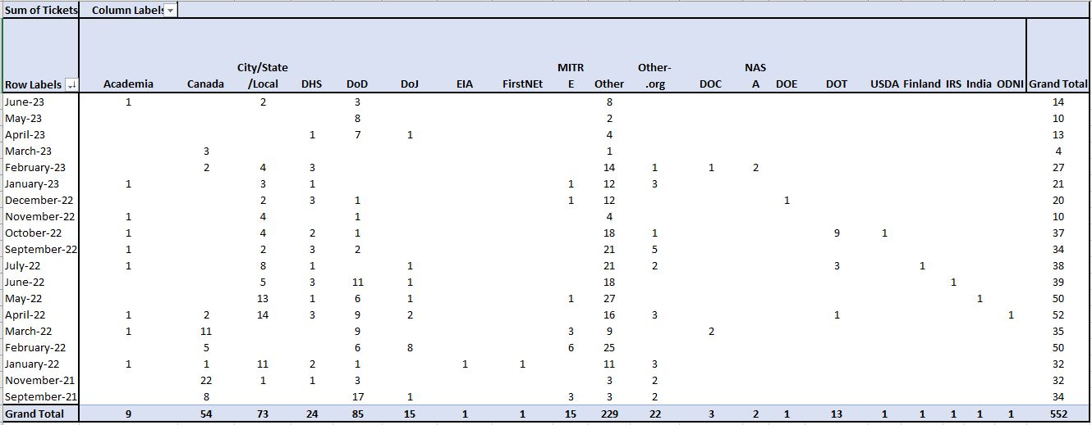
Training Statistics (550+ Attendees since SEP 21)
Next Steps:
Hybrid Offering to Reduce Training Delivery Costs (6-8 Hrs. Hybrid Instructor & Support LOE vs. 24 Hrs. Instructor Led Format)
Update Curriculum to reflect NIEM Version 6.0 Changes
Expand Instructor Pool – Promote NIEMOpen In- kind Instructor Contribution from NIEMOpen Sponsors/Members
Explore Awarding Course Completion Certificates, Credentialing, Accreditation, PDUs
Embed NIEMOpen Training with Commercial/Vendor Provider Offerings
Implement LMS - Potential Revenue Builder for NIEMOpen
11

